Slide 1
Display Builder
Kay Kasemir
July 2026

Slide 2
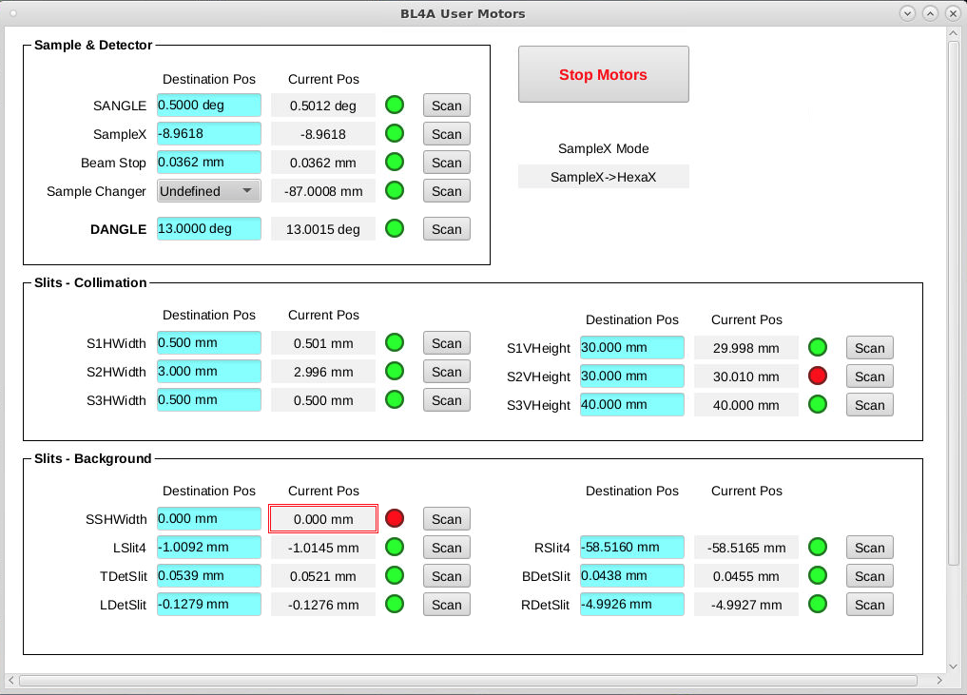
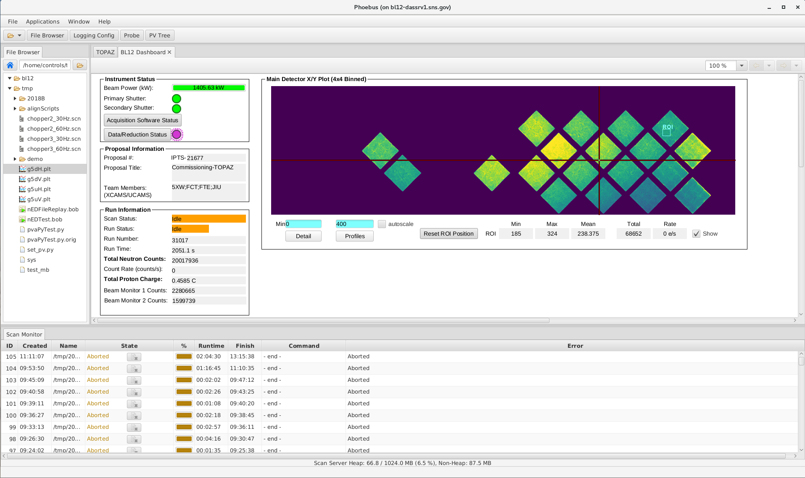
Display Builder
Operator Interface Editor and Runtime
Builds on ideas from EPICS edd/dm, medm, edm (~2000), ..
Very compatible with CS-Studio ‘BOY’ from ~2009
Started ~2015 in CS-Studio/Eclipse, now in CS-Studio/Phoebus
Since 2019 also available as Web Runtime

Slide 3
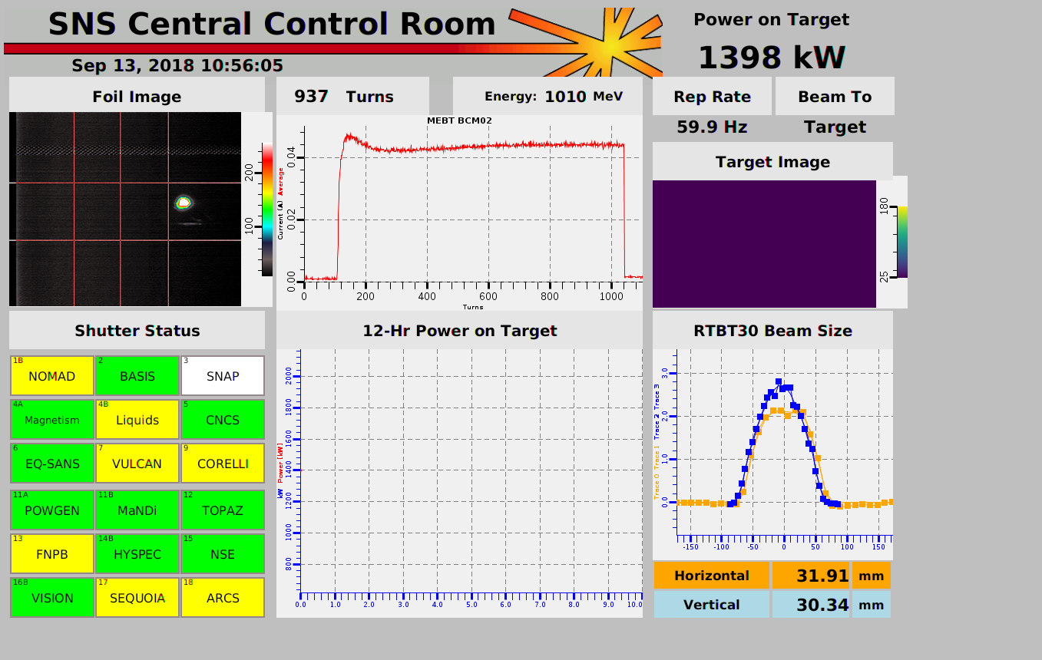
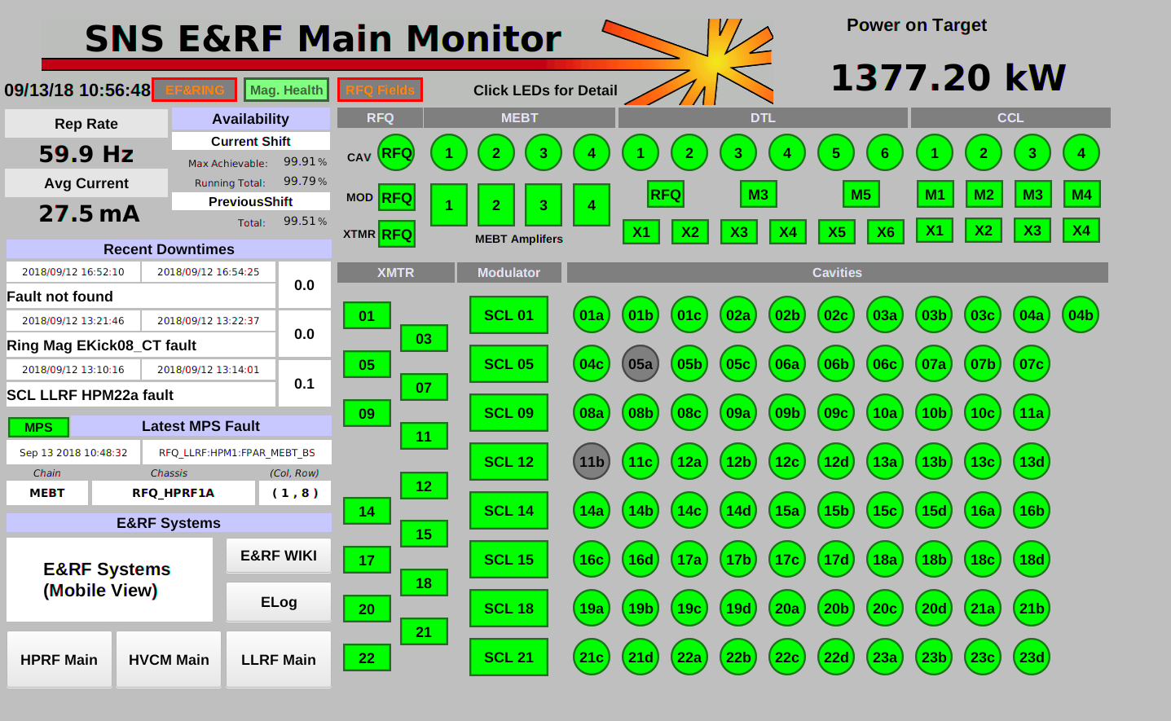
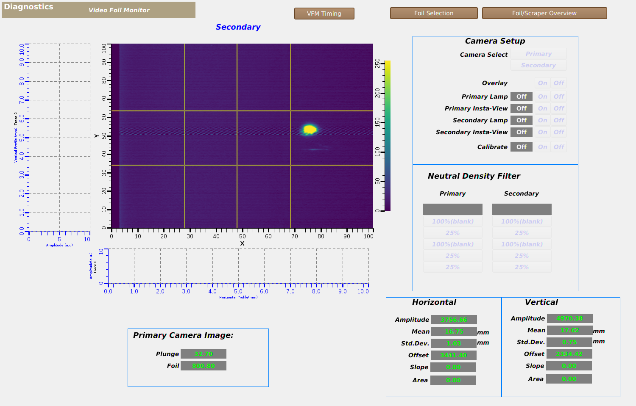
Examples: SNS Accelerator
CS-Studio ‘BOY’ *.opi files

Slide 4
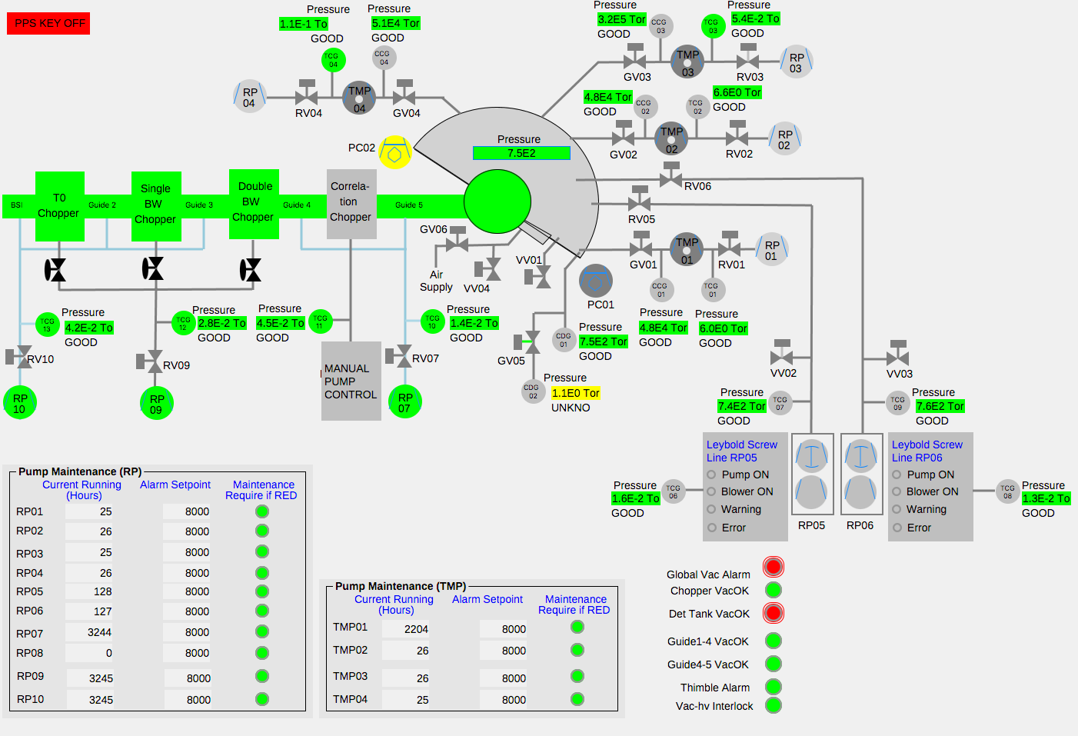
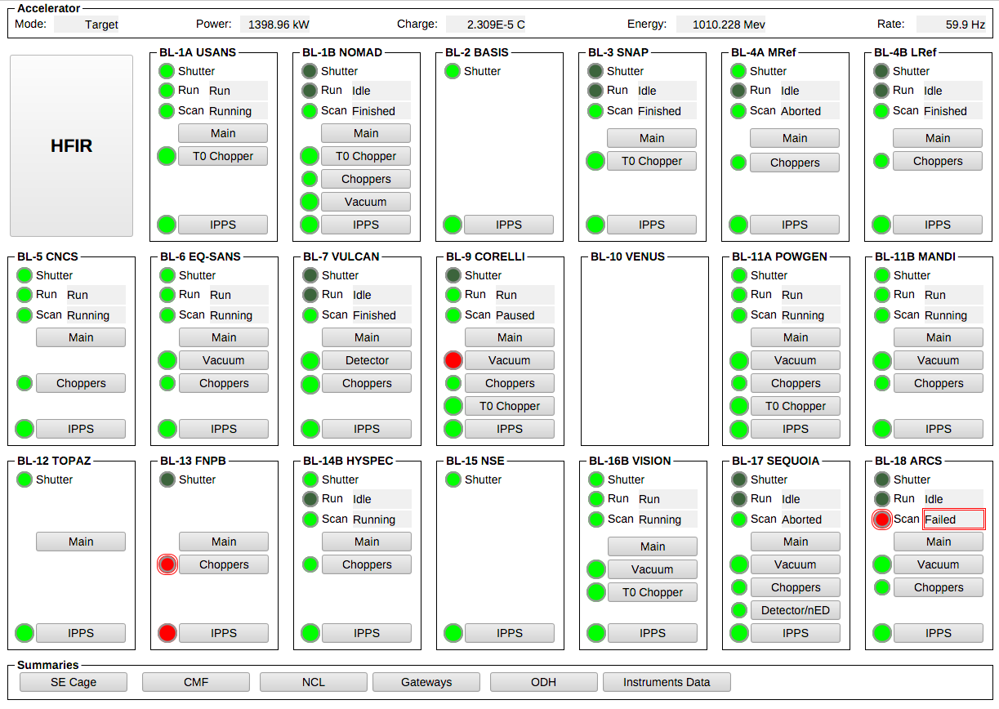
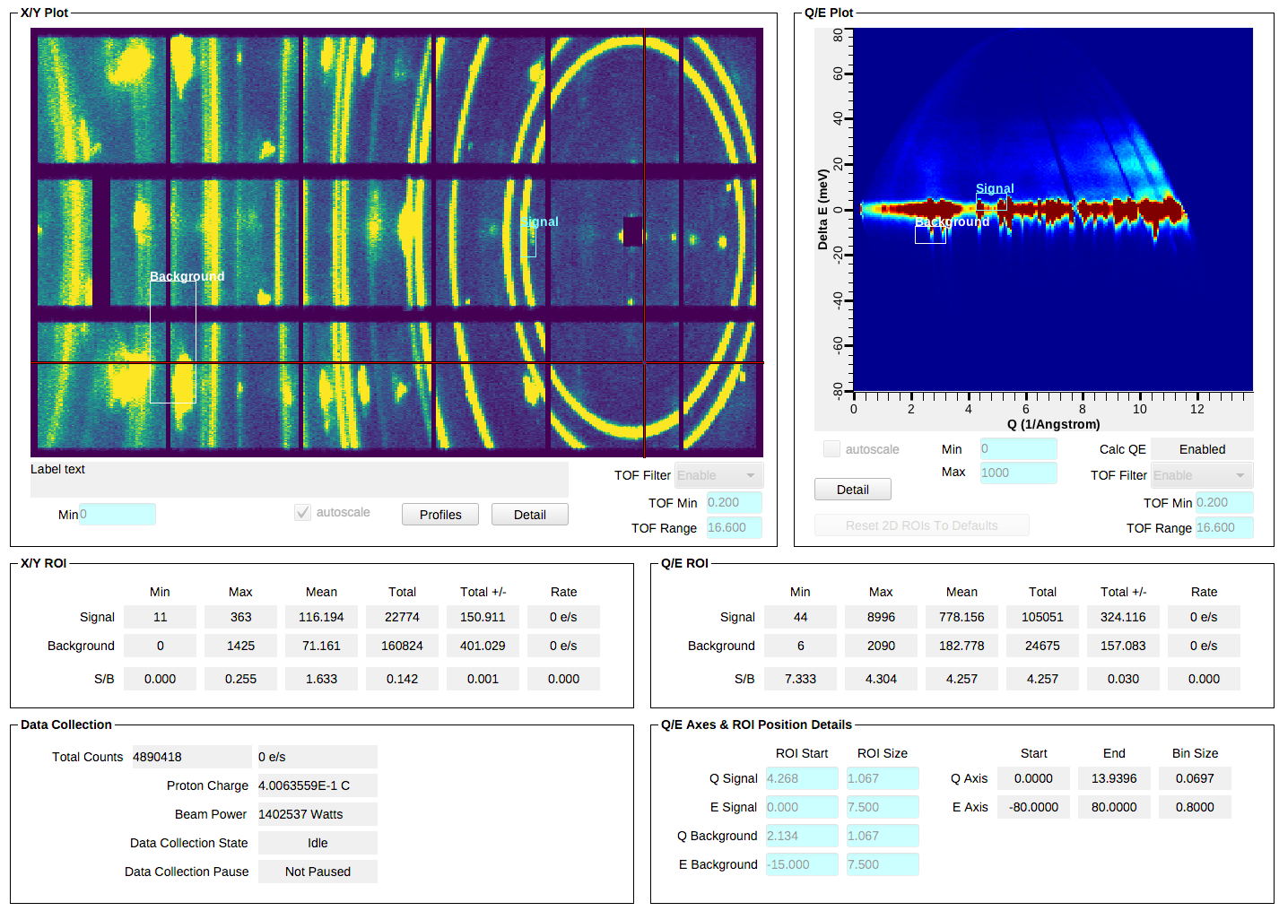
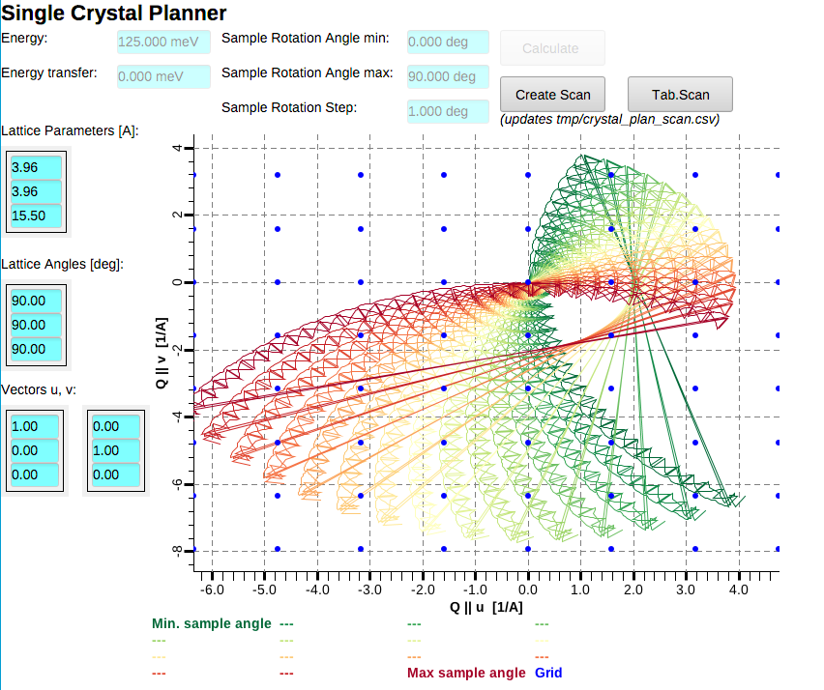
Examples: SNS Beam Lines

Slide 5
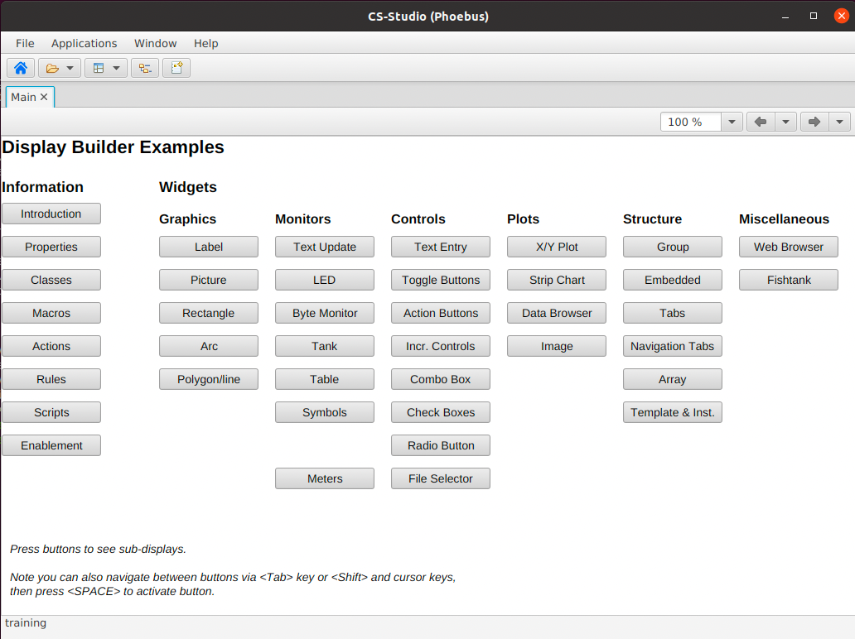
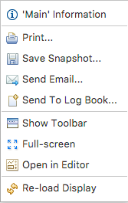
Browse the Examples
Start CSS/Phoebus
Your setup might have a menu entry
  File, Top Resources, Examples
If not, or if you’d like to inspect and edit the examples
  Applications, Display, Examples, Install Example Displays
Main Application Toolbar
Menu Window, Show Toolbar
Tab
Hover mouse,
open Context Menu, Close
Display Runtime Toolbar
Context Menu Window,
Show / Hide Toolbar
Navigate back/forward
also via Alt-Left, Alt-Right cursor keys
Zoom
to view large control room displays on office computer
Example Display
Push any of the buttons
Context Menu
Details change with widget
on which menu was invoked

Slide 6
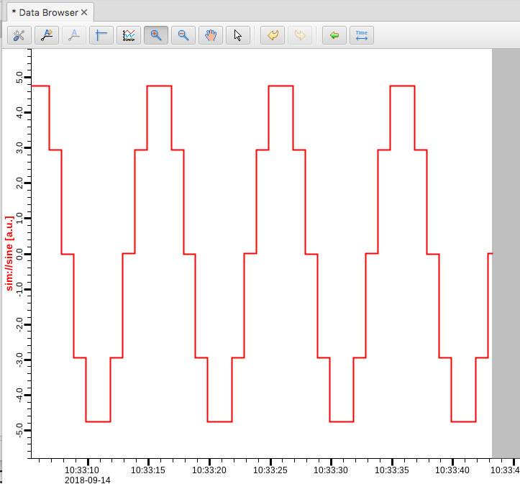
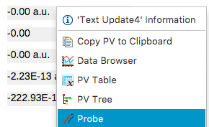
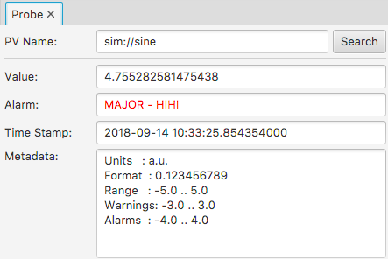
Send PV to other Tools
Context menu opens other tool with PV

Slide 7
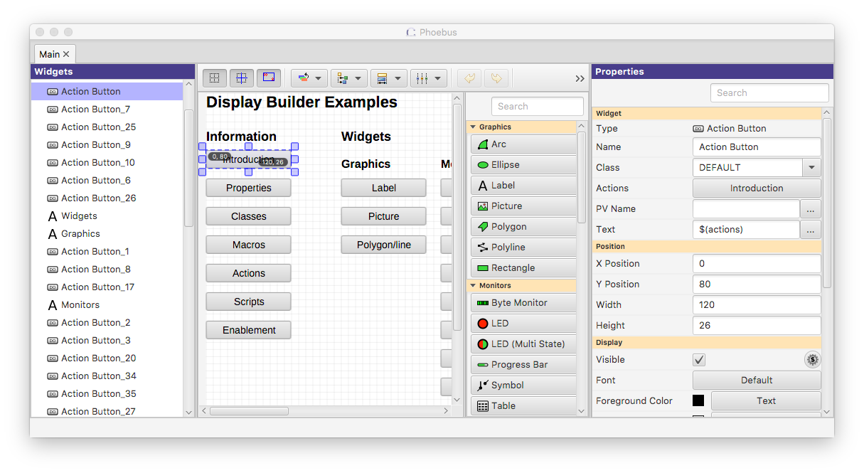
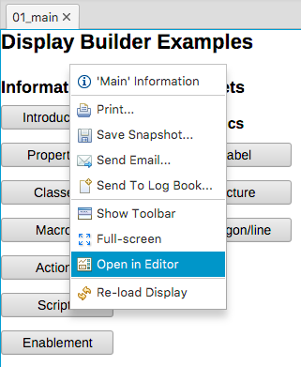
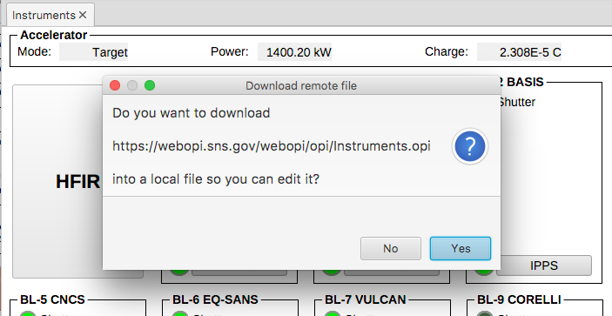
Open Existing Display In Editor
Context menu can open any display in Editor
Downloads remote files

Slide 8
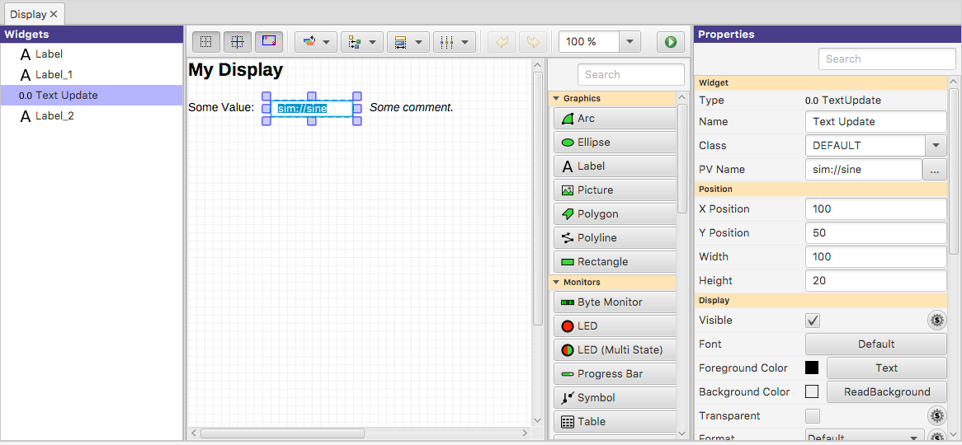
Create New Display
Menu Applications, Display, New Display
  Enter a name with .bob file extension
Property Panel
Edit properties of selected widgets
Save & Execute the Display
Main Editor Area
Select Widgets
Move, resize widgets
Ctrl-C, V, X to copy, paste, delete (⌘ on Mac)

Slide 9
Editing a Display
Widget Palette
Drag widget into editor
- or -
1) Select Widget Type
2) Draw rectangular area in display
Selecting Widgets
a) Click single widget
b) Ctrl-click to add widget (⌘ on Mac)
c) Drag ‘rubberband’ around widgets
d) Click or Ctrl/ ⌘ click in widget list
Quick Edit
Double-click widget to
a) Edit text of Label
b) Edit PV of widgets that use a PV

Slide 10
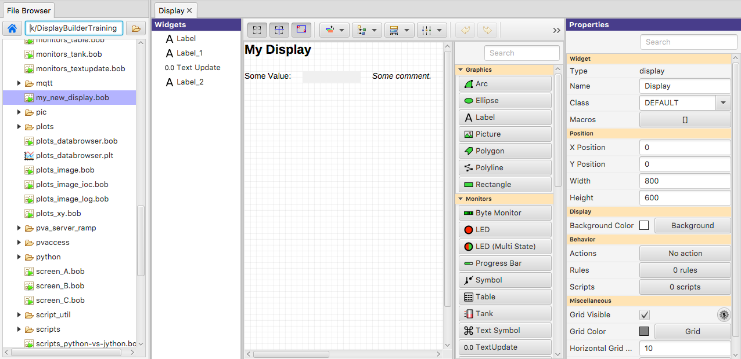
Suggested Setup for Editing
Pick a top directory, for example where you installed the example files
Open Applications, Utility, File Browser
  Set it to your top directory
  On file browser tab, open context menu, “Split Horizontally”, then “Lock Pane”
Menu Window,
Save Layout As..
  “Editing”
Menu Applications,
Display, New Display
  Create new file
  in your top directory
File Browser
Set to your “top” directory.
Locked.
Edit vs. Run
a) Double-click to run.
b) Right-click, Open With.., Editor

Slide 11
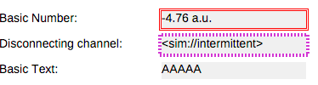
Keep It Simple
Add a Widget
Enter Label’s Text or Widget’s PV Name
Done
At Runtime, widget will
Show PV’s value, formatted, with units
Indicate alarm, disconnect
Show tool-tip with PV name and value
Combo options read from Enum PV, slider range from numeric PV
Disabled when ‘control’ widget has no PV write access

Slide 12
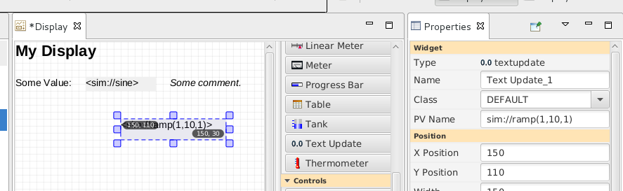
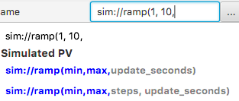
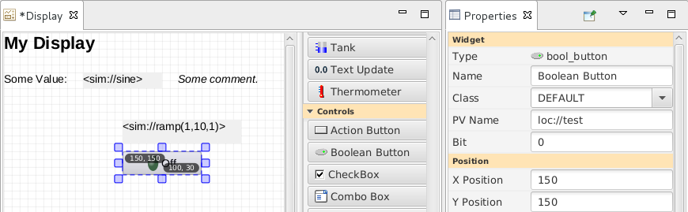
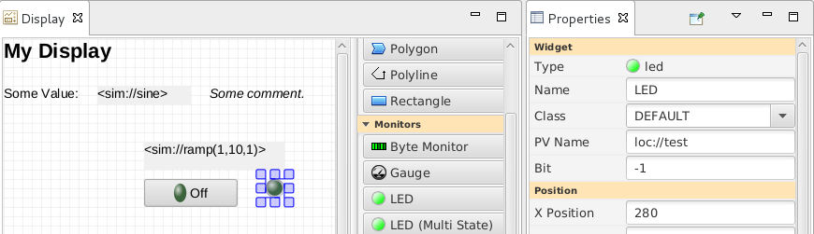
Extend the First Display
Drag a “Text Update” from the palette
  Enter PV name “sim://ramp(1, 10, 1)”.
  Note PV name auto-completion popup.
Add “Boolean Button”
  PV name “loc://test”
Add “LED”
  PV name “loc://test”.
  Note name in PV History.
Execute the display
  Toolbar Button or Context Menu

Slide 13
PV Names
ca://some_pv_name
  EPICS Channel Access PV
some_pv_name
  Typically same, since “ca://” is the default
  Eventually, “pva://” may become the default
sim://sine
  Simulated PV. See auto-completion hints
loc://x(4)
  Local PV. See auto-completion hints
pva://x
  EPICS PV Access

Slide 14
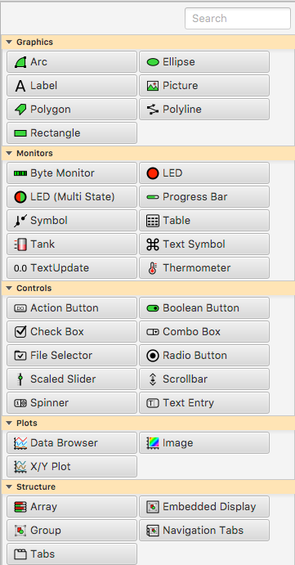
Widget Palette
Shows all available widgets
  Enter name for ”Search”
  Hover mouse for description
  Drag -or- Select & Rubberband
Categories
  Graphics show static label, picture, ..
  Monitors update based on reading a PV
  Controls read a PV and can write to the PV
  Plots tend to read from one or more (waveform) PVs
  Structures group widgets, embed sub-displays

Slide 15
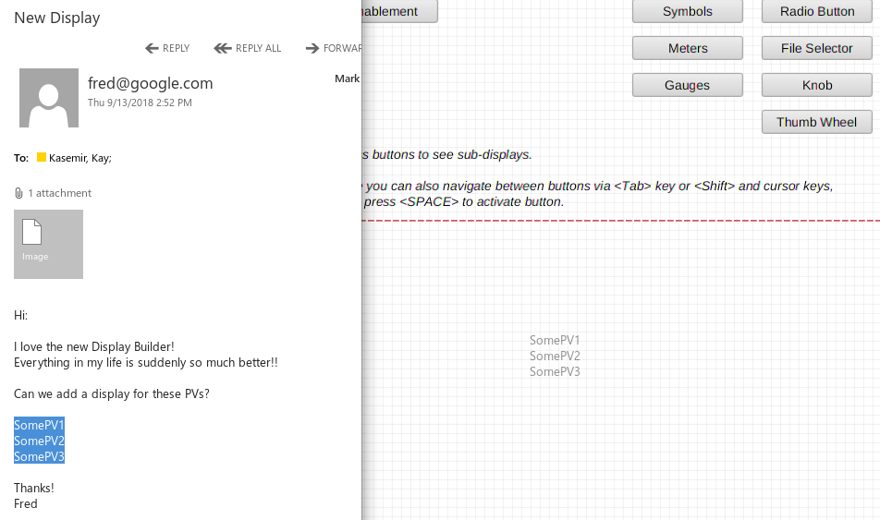
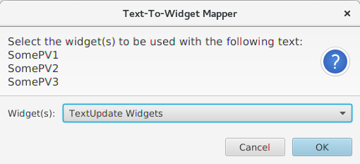
Create Widgets via Drag/Drop from other Apps
Email with list of PVs?
  Drag that text into
  Display Editor
  Select widget type
Supported:
  Text → Label
  Text → PV Widget
  Image File → Picture Widget
  *.bob File → Embedded Display Widget

Slide 16
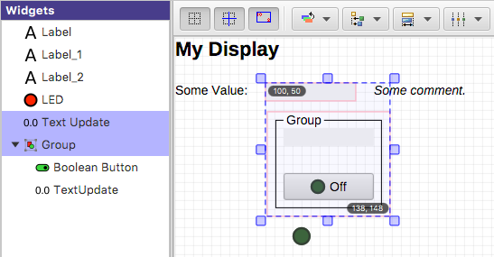
Manipulating Widgets
Show Coordinates
Snap to Grid
.. Other Widgets
Order
Front/Back
Size
Align
Widget List
Select widgets
Rename Widgets
View/change their order.
Distribute
Selected Widgets Tracker
Move or resize selected widgets

Slide 17
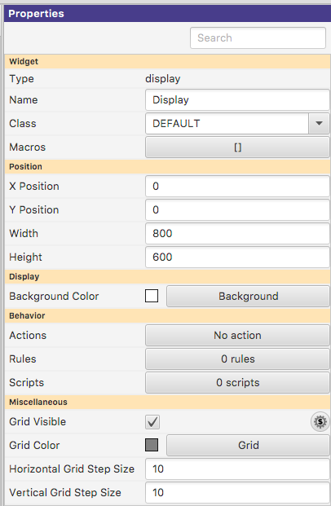
Display Properties
Click on display background to select no widget for editing overall display properties
Name
  Shown in Tab
Macros
  Used by all widgets in this display
Grid size
  Can aid with placing widgets

Slide 18
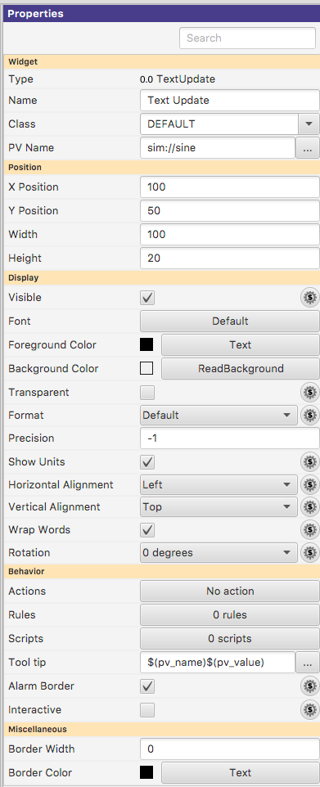
Widget Properties
Select one (or more) widgets to edit their (common) properties
Search
  To find desired property
PV Name
  Most important property for most widgets
Details depend on the widget type

Slide 19
Common Widget Properties
Defaults tend to be reasonable:
  Format with precision set by PV
  Show units provided by PV
  Alarm-sensitive Border
  Fetch Items (Combo, …) from PV
  Instead of changing them,
  maybe the PV needs to be updated?
  Still, can be adjusted as needed for the display.

Slide 20
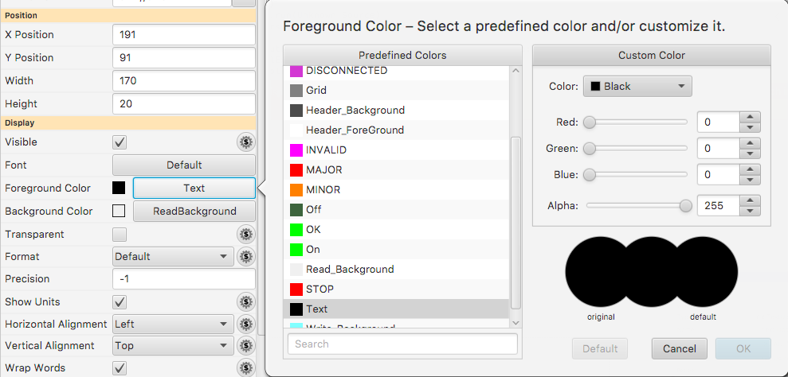
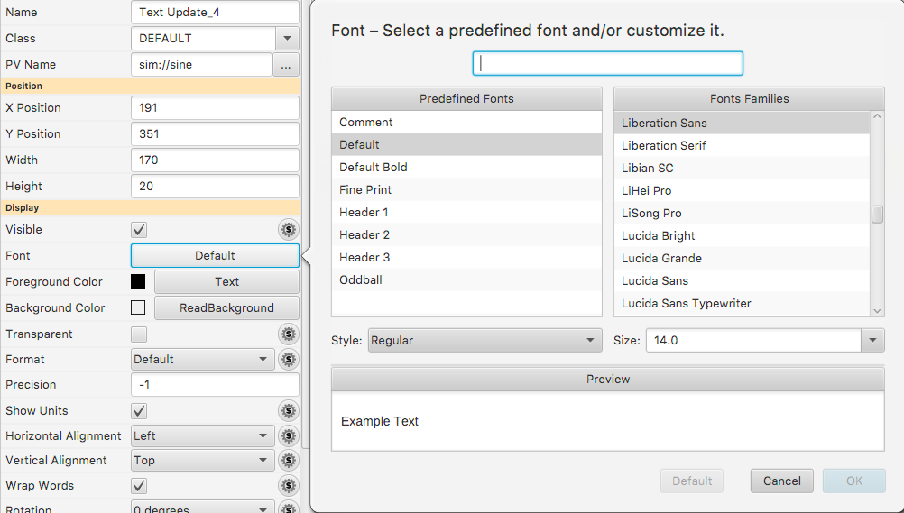
Predefined “Named” Colors and Fonts
Use whenever
possible!

Slide 21
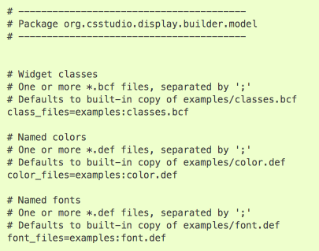
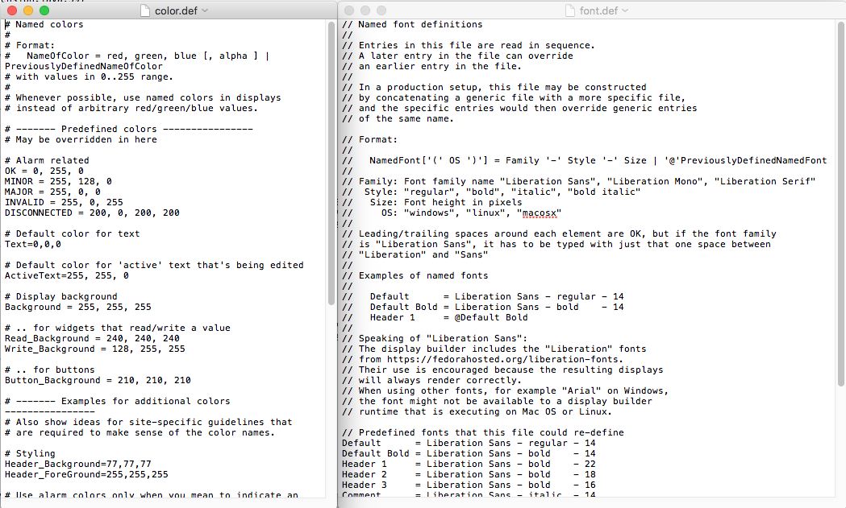
Configuring Named Colors, Fonts
Ideally set at start of project

Slide 22
Widget Notes
Text Entry, Text Update:
  Set Format = String for “long string” waveforms. Default will show array.
LED, Boolean Button, Checkbox
  Boolean PV
  Numeric PV 0 or not 0 (when ”Bit” set to default of -1)
  Bit in a numeric PV (when ”Bit” set to 0, 1, 2, …)
Multi-State LED
  Enumerated or numeric PVs
  Defaults to using state values 0, 1, 2, 3, ..

Slide 23
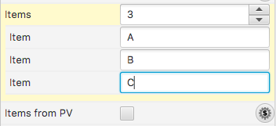
Widget Notes
Combo Box, Radio Button:
  Best for enumerated PV: Enter PV name, done
  Alternatively, un-check “Items from PV” and enter items

Slide 24
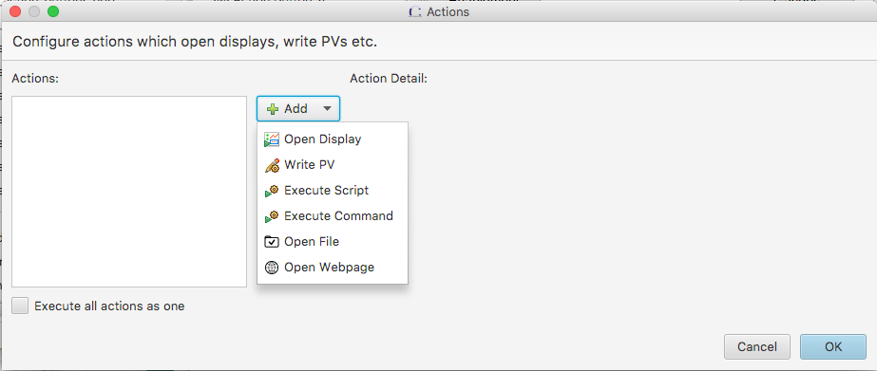
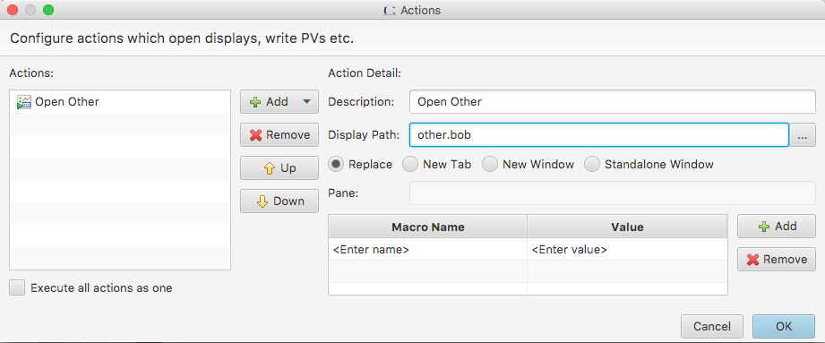
Action Button
Add ActionButton
Configure “Actions” property, add “Open Display”
Run: Clicking button opens the “other” display.
In principle, any widget can have ‘Actions’.
They appear in the widget’s runtime context menu.
But it’s not obvious to end users that for example a Label will have actions.

Slide 25

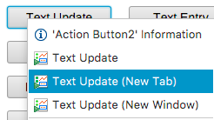
Screen Navigation
Replace
  Suggested default.
  Allows back/forward navigation as in web browser
  Minimizes number of open screens
New Tab
  Opens in new tab
  Allows specific Pane name
New Window
  Opens in new window
With “Replace”, can still use
  Context menu
  Control (⌘ on Mac) for tab
  Shift-Control for window

Slide 26
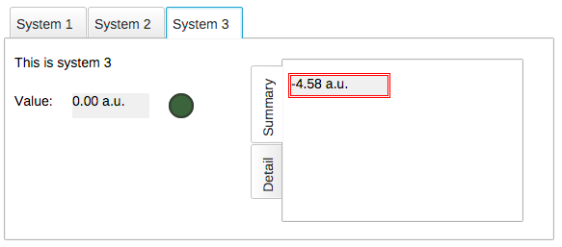
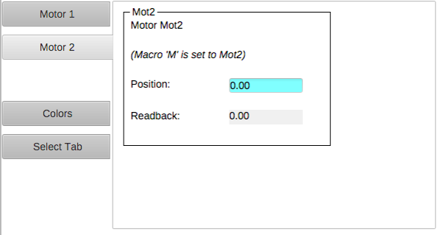
Screen Navigation: Tabs
Tabs
Each tab is in-memory, same *.bob
Appears immediately when selected
Uses CPU and memory when hidden
Navigation Tabs
Tab is loaded from separate *.bob
when selected
May need a little time to load
No CPU and memory when hidden

Slide 27
Macros
Macros are passed into displays from
  Enclosing Group or Tab Widget
  Display
  Embedded widget container or Action that loaded the display
  Phoebus preferences
  Environment Variables
To use: $(NameOfMacro)
Examples:
  PV Name: $(PV) with PV=TheFullPVName
  PV Name: Motor$(N) with N=1, 2, 3, …
  Width: $(WID) with WID=200
  Visible: $(SHOW) with SHOW=true
.. or ${NameOfMacro}.
EPICS *.db files use $(xx),
SNL and shell use ${xx},
so we support both conventions.

Slide 28
Macro Example
sub.bob
“Motor $(N)”
top.bob
Create display “sub.bob”
  Label with text “Motor $(N)”
  TextUpdate with PV “loc://pos$(N)(10)”
  ActionButton with PV Name “loc://pos$(N)(10)”
  and Action to “Write PV” value 20
  Copy that button, update to set PV to 30
Create display “top.bob”
  ActionButton with Action to open sub.bob with N=1
  Copy/paste the button, update to N=2
Execute top.bob, press buttons
N=1
sub.bob
“Motor 1”
N=2
sub.bob
“Motor 2”

Slide 29


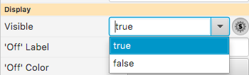

Macros
Default values: $(MACRO=default)
  Allows standalone testing
  without passing values into
  display
To enter macro for Boolean
  Press the “$” macro button
  Select valid option
  from drop-down …
  .. or enter a macro

Slide 30
Macro Fallbacks
When macro is not defined, falls back to
  Widget Properties
    Uses the internal property name shown in tool-tip of Properties view
    Note how tooltip is usually preset to “$(pv_name)\n$(pv_value)”
    Action Button has PV Name property.
    It’s not used directly as in other widgets with PV name,
    but in “Write PV” the PV name is preset to $(pv_name)
    Action Button text is preset to “$(actions)”
  Java Properties
    $(os.name)
  Environment Variables
    $(HOME), $(USER)

Slide 31
Predefined Macros
  $(DID): Unique display identifier, useful for per-display PVs
  loc://x$(DID)(10)
  $(DNAME): Display Name

Slide 32
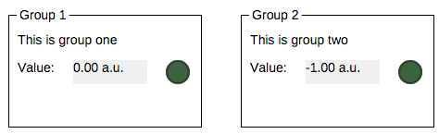
Group Widget
Contains other widgets
Visual Effect:
  Border, Name
Practical Effect:
  Group can define macros for contained widgets
  Group can be moved, copied/pasted as one unit in editor

Slide 33
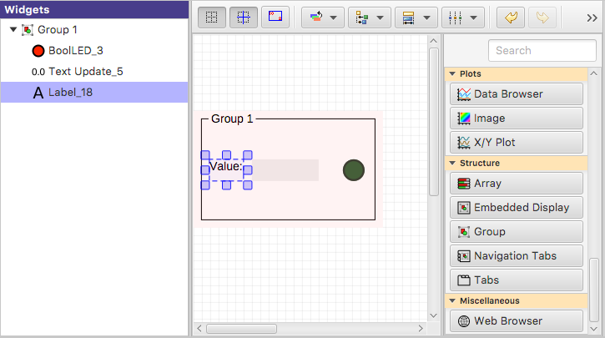
Group Widget
1) Add Group Widget
2) Move other widgets inside the Group
Active Group is highlighted

Slide 34
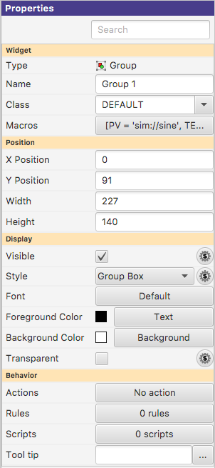
Group Properties
Name:
Shown in border
Style:
“Group Box” for named border
Macros:
Passed to contained widgets

Slide 35
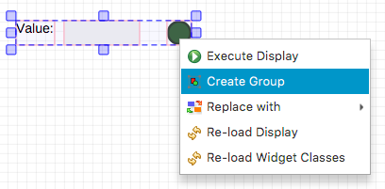
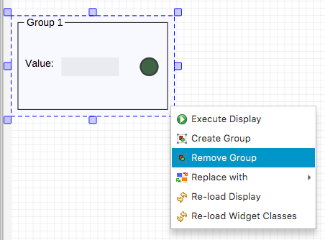
Group Editing Shortcuts
Select Widgets
Context menu “Create ..”
Select Group
Context Menu “Remove..”

Slide 36
Embedded Display
Hosts a complete *.bob file within a widget
Allows composing higher-level displays from smaller displays:
  Per-device *.bob
  Show multiple devices in one display

Slide 37
Embedded Display Example
Create display “sub.bob” (or use the one created earlier)
  Label with text “Motor $(N)”
  TextUpdate with PV “loc://pos$(N)(10)”
Create display “main.bob”
  Embedded Display, File sub.bob, Macros N=1
  Copy/paste the Embedded Display, update to N=2
Execute main.bob
sub.bob
“Motor $(N)”
main.bob
N=1
N=2
sub.bob
“Motor 1”
sub.bob
“Motor 1”

Slide 38
Embedded Display Sizes
Embedded Display Size
  Size of the widget that will host the *.bob
  Defined by the widget Width and Height properties
Content Size
  Size of the *.bob
  Defined by that Display Width and Height properties
What if those sizes differ?

Slide 39
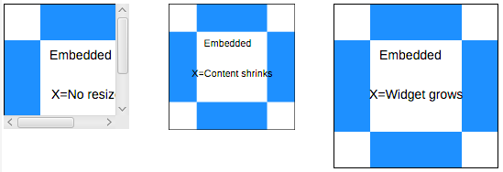
Embedded Display Resize Options
No Resize
Size content to fit widget
Size widget to fit content
No Resize usually best. Scrollbars appear as needed.
Resizing results in odd font sizes or widgets that outgrow their initial space.

Slide 40
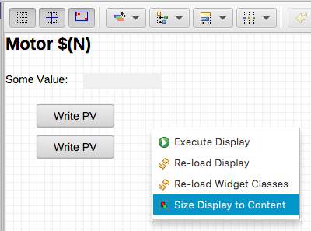
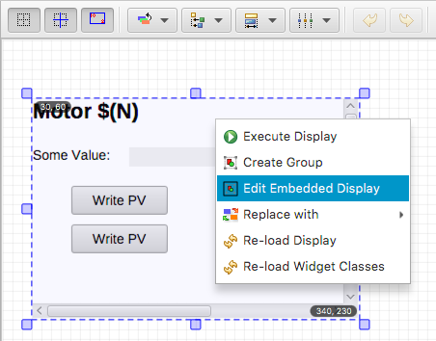
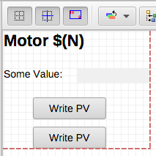
Embedded Display Editing

Slide 41


Slide 42

Top Resources
See Help, Preferences Listing
Start phoebus with “-settings /path/to/my_settings.ini”:
  org.phoebus.ui/top_resources=/home/controls/displays/main.bob, Start Page |
  http://controls.my.site/displays/main.bob, Start Page
  File system: Use NFS or ‘git pull’ to distribute files
  http: All users always see the same set of files

Slide 43
Many Widgets and Properties
Compared to earlier EPICS display tools,
  Group Widget instead of Lines
  LED instead of Circle-with-changing-color
  Tab/Navigation Tabs instead of buttons, local PVs, conditional visibility,..
Display describes Meaning:
  Group of related widgets
  LED for binary PV, not circle that happens to change color
Files with meaning are easier to translate into the next tool

Slide 44

Widget Classes
Instead of creating a Label with large font, define a “TITLE” class for the Label
Instead of creating an LED with Orange color, define a “WARNING” LED class

Slide 45

Editing *.bcf Widget Class Files
Name Defines a widget Class:
‘WARNING’ LED,
‘TITLE’ Label,
…
Slightly different editor behavior
Checked Property:
Value becomes part of class definition

Slide 46


Using Widget Classes
Select Widget Class
Class Indicator:
Property is handled by class
Disabled:
Cannot change the class-based property
Context Menu:
Re-load classes in case *.bcf is changed while editing display

Slide 47
Class Details
*.bcf files define widget classes
  Label of class TITLE uses font XYZ
When editing a *.bob file, classes are applied.
Add Label, select Class TITLE:
  Font is set to XYZ
  Can no longer change the font
  File is saved with font=XYZ, marked as “use_class”
*.bob files use widget classes, if they are defined.
Open a file with Label of class TITLE, and
  TITLE is a known class:
  Whatever that class defines is used. If it sets font=EFG, that’ll be used.
  TITLE is not a known class:
  Using font=XYZ as saved in file.

Slide 48
Compare *.bcf and *.bob to *.css and *.html
*.bcf classes are similar to *.css style settings,
*.bob files are similar to *.html content
Have same *.bcf/*.css
  → Display looks the same
Use different *.bcf/*.css
  → Display looks as requested in my *.bcf/*.css
Have no *.bcf/*.css
  →*.html turns into rubbish, lacking any description of what to look like.
  *.bob display looks as seen by last person who edited it,
  since the class settings effective at that time are in the *.bob file.

Slide 49

Rules
Ideally, use widgets’ built-in functionality
  Value of PV displayed in TextUpdate, LED, ..
  Alarm indicated via Border
Sometimes useful to for example hide a widget, i.e. change visibility based on a PV
  Rules can accomplish this
  .. But functionality may not be obvious to the next person who needs to maintain a display

Slide 50


Adding a Rule
Add TextUpdate widget
Set PV to sim://ramp(0, 10, 1)
Open Widget’s Rules
Add Rule, name it “Hide”
Select “visible” property
Add PV sim://ramp(0, 10, 1)
Add Boolean
Expression
“pv0>8”
Un-check value
Run

Slide 51

Rules Detail
Triggered by at least one PV
  May use additional non-trigger PVs
Expressions use pv0, pv1, .., pvStr0, pvStr1, .. to access PVs’ values
Rule internally converted to Jython
  Use preview to debug
“else: ..” sets property to original value

Slide 52
Scripts
Scripts are attached to a widget
Triggered by at least one PV
  May use additional non-trigger PVs
Invoked with
  pvs[] – Array of requested PVs
  widget – The widget
Script can
  Read & write the received PVs
  Set widget properties
  Locate other widgets in the display
  Invoke any Java code in the product
  Be very powerful
  Result in an unmaintainable mess
One Script Executor per *.bob file,
Runs in background thread
  Slow scripts do not block the UI
  One script per display at a time
    Many short-duration scripts
    One that never quits

Slide 53
Rules vs. Scripts
Both are in the end Jython code
Both should be the exception.
Plain displays don’t need them.
But can be powerful,
replacing separate custom Java/Python/C/C++ applications.
Prefer Rules because they describe meaning, easier to maintain

Slide 54
When to use a script
It’s simple, well documented, and tremendously improves the UI
Would be a one-of, specialized, hard to maintain, separate application anyway.
With a script, at least its integrated into the operator UI
Examples:
Turn scalar PVs into loc://waveform for guideline in XYPlot
Fill display with 50 widgets based on config file, examples/template_and_script
Add information from web service to display

Slide 55
When not to use a script
It adds logic to the display that should be on the IOC
  Display should only display PVs and allow user to write PVs.
  Display must never do anything
You have to ask for help implementing the script
  If you can’t implement it, you can’t maintain it, either
Examples
Open relieve valve when pressure too high.
Ramp Power Supply.
  What if somebody closes the display? Opens two displays?
Wiggle something on the display
  It’s not a video game

Slide 56
Summary
Display Builder is powerful
Editor and Runtime with
many Widgets, Macros etc.
Keep it Simple
Add a Widget
Enter Label’s Text or
Widget’s PV Name
Done

